Slide 1
Multi-Robot Extension to Orbit Lab
Presented by,
Atul Srivastava
Notes:
Where the idea came from

Slide 2
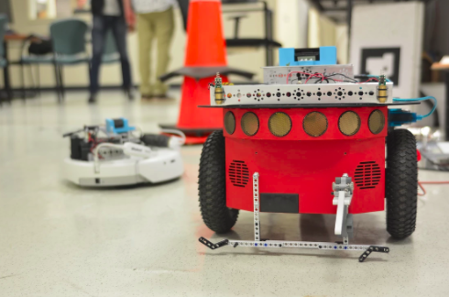
Objective:
Create network of mobile robots
Extension to ORBIT

Slide 3
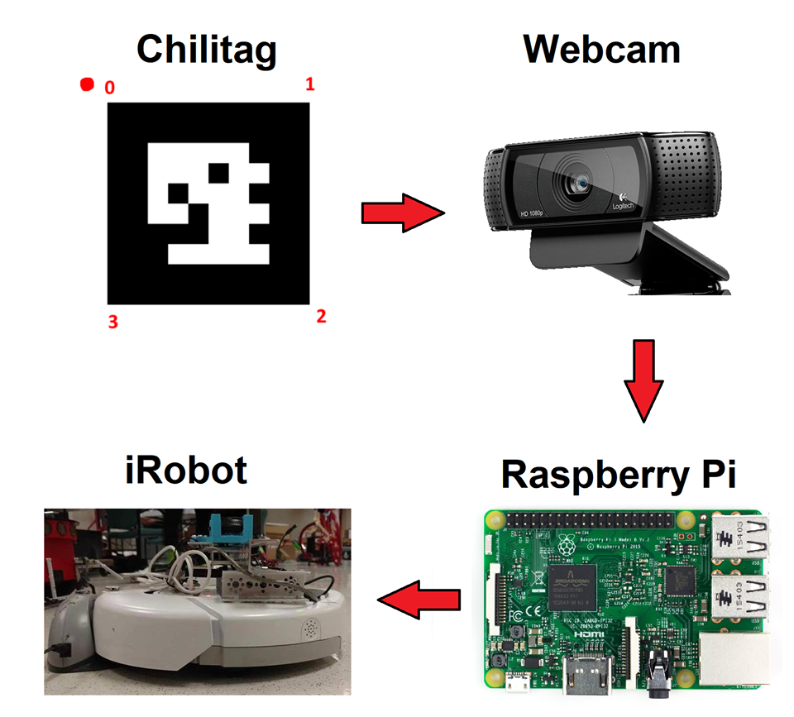

Slide 4
Thank you for your time...
...Any Questions?

